Slide 1
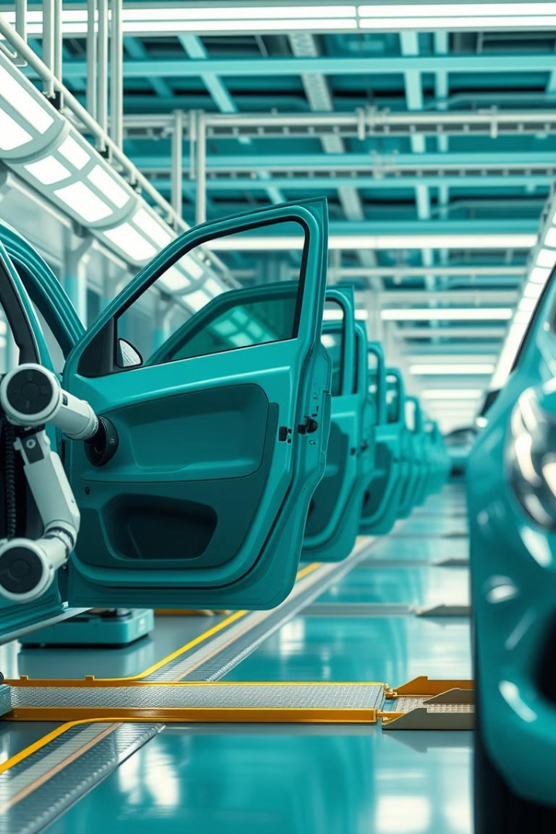
Production line to assemble Doors
Dr. Zabihifar - Industrial Robotics – Winter 2025
Alireza Jarolahi Artin Mokhtariha Mohsen Hashemi

Slide 2
Introduction
The project involves simulating a production line for assembling car doors using RoboDK, a powerful and versatile offline programming and simulation software for industrial robots. The objective of this simulation is to automate the process of picking up car doors from a designated table, placing them on the car, and attaching them via hinges. This simulation was carried out using two Kuka KR50 R2500 arm robots, positioned symmetrically on the left and right sides of the production line.
Objective
The primary goal of the project was to design and simulate an automated assembly line in RoboDK to assemble car doors, with the following key steps:
Picking up the car doors from a designated table.
Placing the doors onto a car.
Attaching the doors using hinges designed for the simulation.
Ensuring that the robots perform the required tasks with precision, with inverse kinematics handled automatically by RoboDK.

Slide 3
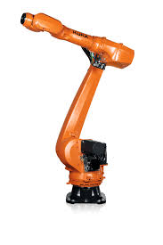
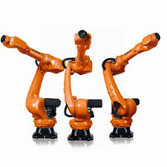
System Setup
1
Robots Used
Kuka KR50 R2500 arm robots: Two Kuka KR50 R2500 robots were employed in the simulation. One robot operates on the left side of the assembly line, and the other operates on the right side. These robots are industrial-grade robotic arms, capable of handling various tasks such as pick and place, assembly, and welding.
2
Reachability
The Kuka KR50 R2500 robots offer a wide reach and are able to effectively pick up and manipulate the car doors.
4
Precision
3
Payload
The precision of the Kuka KR50 allows for accurate placement and attachment of the doors, ensuring that the assembly process remains efficient and error-free.
With a payload of 50 kg, these robots can comfortably handle the weight of a typical car door.

Slide 4
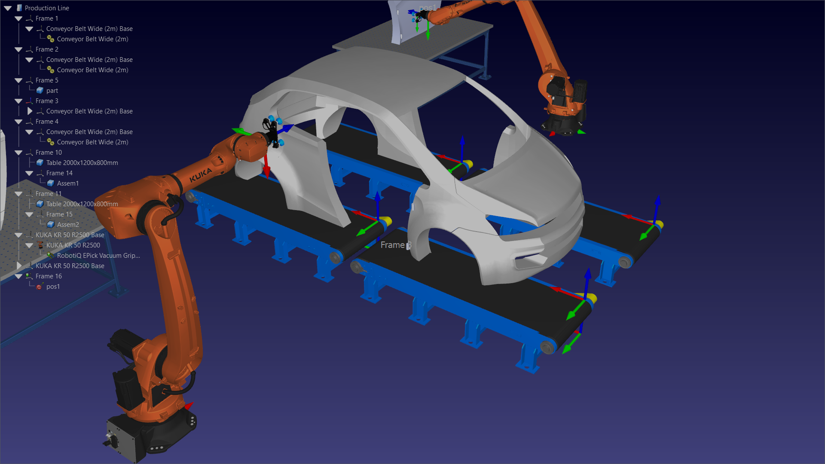
The Workcell
Car Door Table
A table is positioned within the workcell, where the car doors are placed for pickup.
Hinge Mechanism
Custom-designed hinges are used in the simulation, which the robots will attach to the car doors to complete the assembly process.
Workcell
Car Body
The workcell consists of the two robots positioned to work together in a coordinated manner to perform the assembly tasks.
A virtual car body is positioned at a defined location in the workcell, where the robots will place and attach the doors.

Slide 5
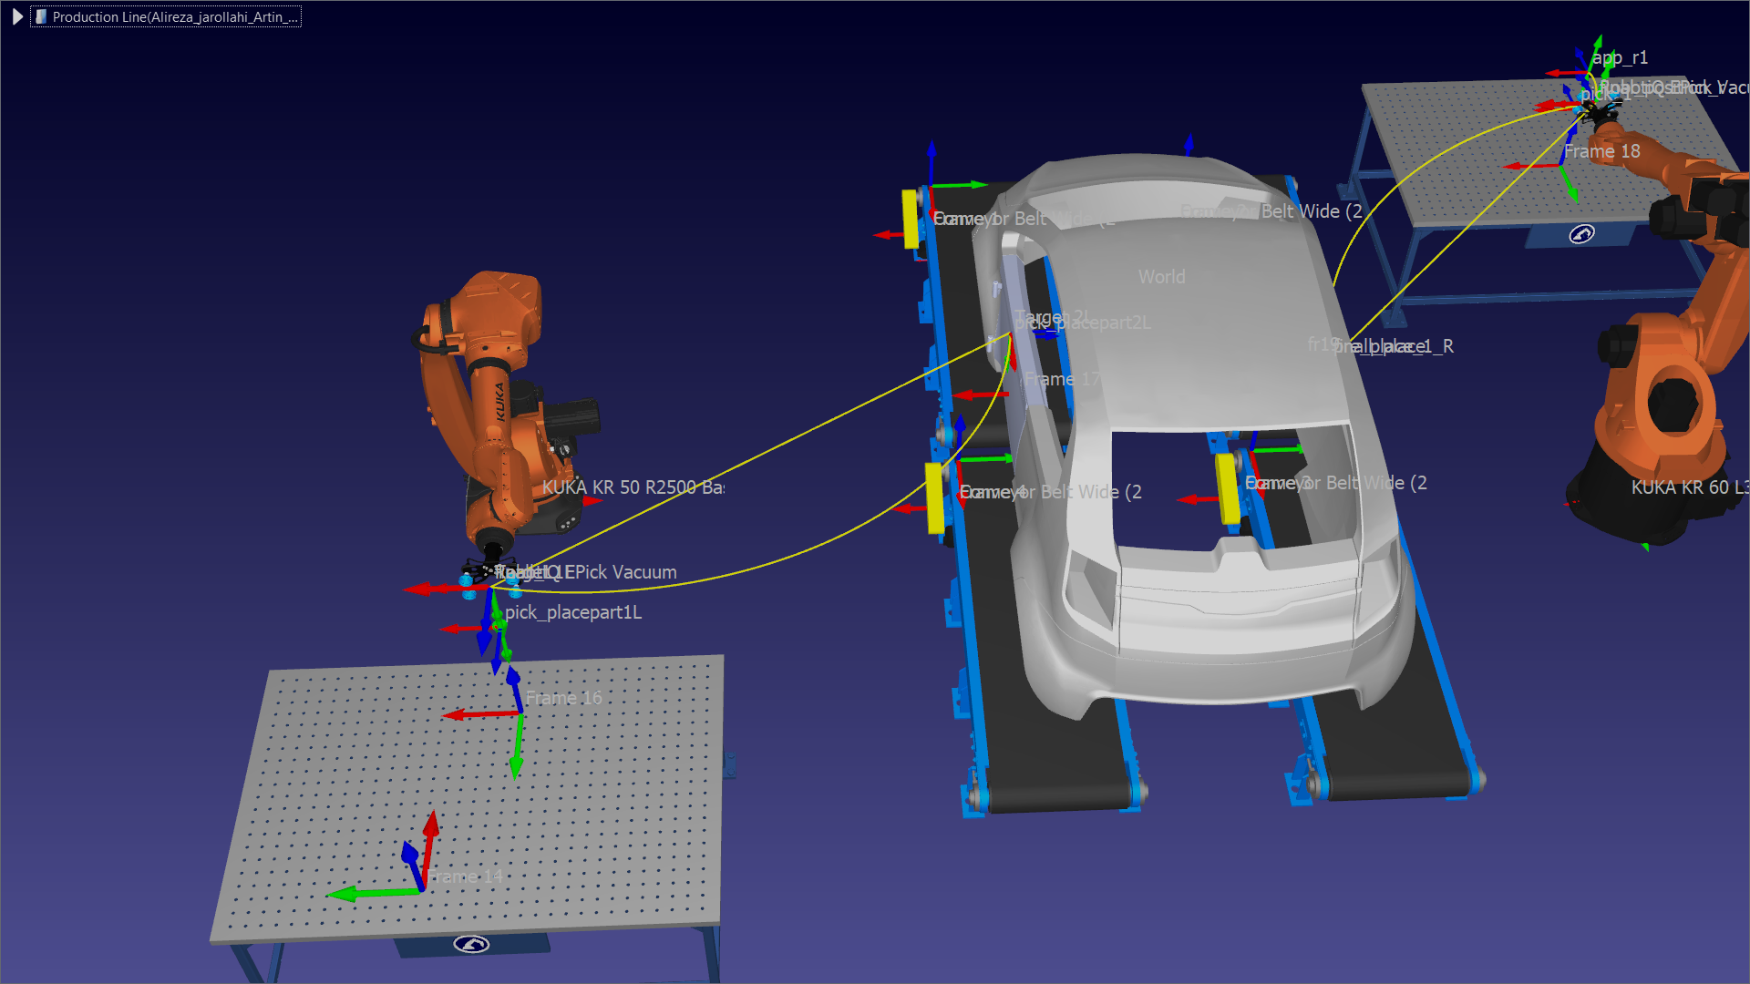

Path Design
Robot Path Programming
We carefully designed a path for the robots to follow, ensuring that they could pick up the doors from the table, transport them without collision, and place them accurately on the car. These paths were programmed in RoboDK, ensuring that the robots’ movements were synchronized.

Slide 6
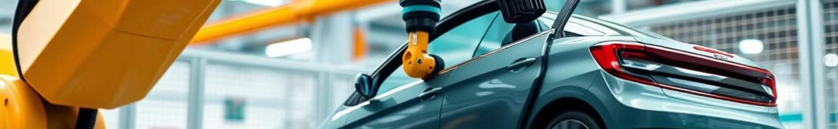
Inverse Kinematics
Target Definition
Sequential Targeting
For each pick and place operation, we defined a target for the robot’s end effector. The target represents the position and orientation that the robot needs to reach with its tool to pick up or place the door.
The robots were programmed to reach each of these targets sequentially. The software handles the calculations, ensuring smooth and efficient motion.
1
2
3
Automatic Inverse Kinematics Solving
RoboDK automatically calculated the required joint angles and robot movements to reach each target. This removes the need for manually solving inverse kinematics, which can be complex and time-consuming.

Slide 7
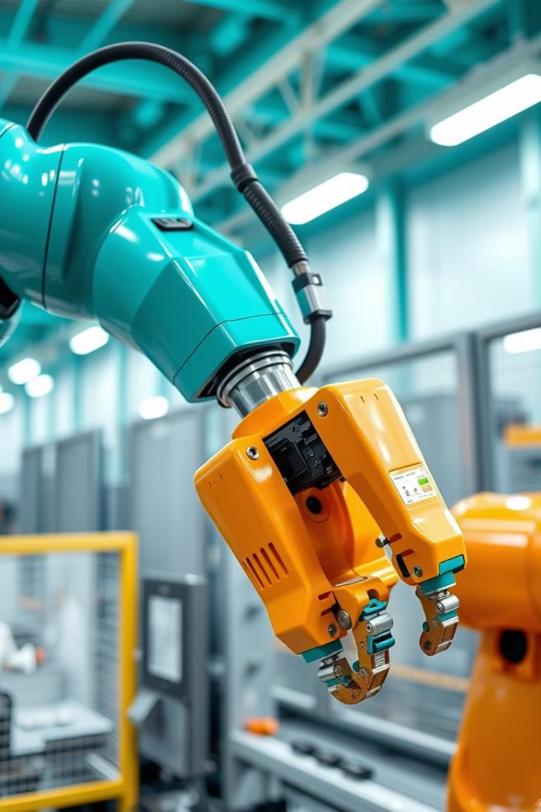
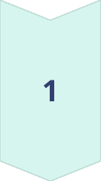
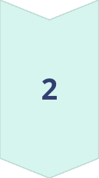

Robot Programming
Pick Operation
The robots were programmed to pick up the car doors from the table. The end effector was equipped with a gripper or suction device to securely hold the door during the transport.
Place Operation
After picking up the door, the robots were programmed to transport the door to the car body and position it correctly for attachment.
Hinge Attachment
The robots then positioned the door correctly and attached it using the pre-designed hinges. The hinges were custom-designed for the simulation to ensure that they matched the door and car body dimensions accurately.

Slide 8



Challenges Encountered
1
Path Optimization
2
Collision Avoidance
3
Hinge Design
While the simulation was successful, several challenges were faced during the development:
Ensuring that the robots followed an efficient path to avoid unnecessary movements and reduce cycle time was a significant challenge. We had to carefully design the robot paths to ensure that the robots did not collide or move inefficiently.
Since two robots were working simultaneously in the same workcell, it was crucial to ensure that their movements did not interfere with one another. RoboDK’s collision detection feature helped to mitigate these issues by alerting us when a potential collision was detected and suggesting modifications to the path.
The hinges were custom-designed, and it was essential that the robots precisely attached them in the correct position to avoid any misalignment during assembly.

Slide 9
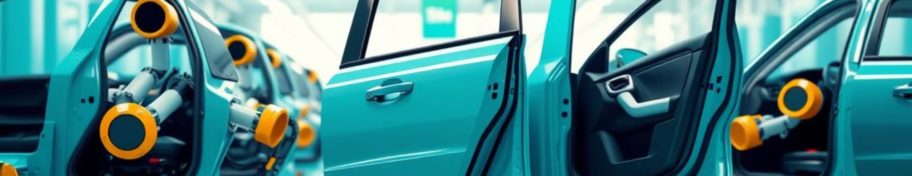
Conclusion and Result
The simulation of the car door assembly line using RoboDK was a successful endeavor. The project demonstrated the capabilities of RoboDK in automating complex industrial processes. The simulation provided valuable insights into the design and implementation of automated assembly lines, highlighting the importance of factors such as robot path planning, collision avoidance, and hinge design. The project also showcased the potential of RoboDK as a powerful tool for offline programming and simulation of industrial robots.

Slide 10
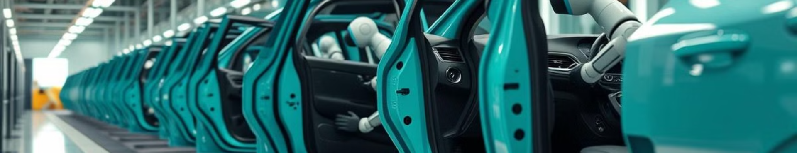
Future Work
Future work could involve expanding the simulation to include additional tasks such as quality inspection and packaging. The simulation could also be enhanced by incorporating more realistic models of the car doors, hinges, and other components. Additionally, the simulation could be used to explore different robot configurations and workcell layouts to optimize the assembly process further.

